Slide 1
CHAPTER 3
STACKS AND QUEUES
All the programs in this file are selected from
Ellis Horowitz, Sartaj Sahni, and Susan Anderson-Freed
“Fundamentals of Data Structures in C”,
Computer Science Press, 1992.
CHAPTER 3
‹#›

Slide 2
A
Stack: a Last-In-First-Out (LIFO) list
B
A
C
B
A
D
C
B
A
E
D
C
B
A
top
D
C
B
A
top
top
top
top
top
Inserting and deleting elements in a stack
CHAPTER 3
‹#›

Slide 3
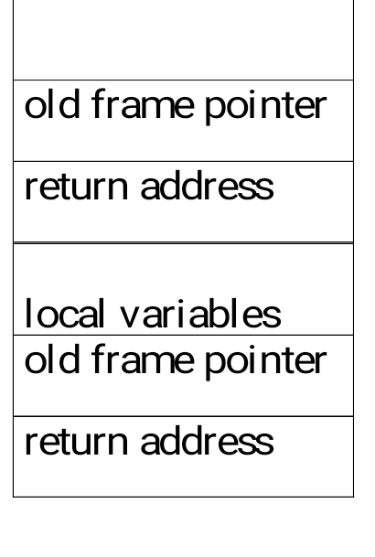
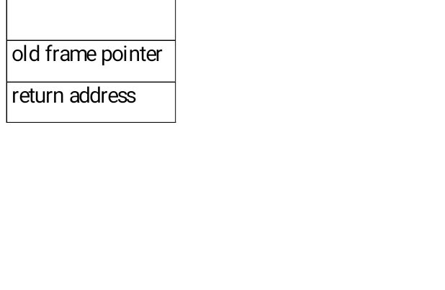
An application of Stack: stack frame of function call
(activation record)
fp: a pointer to current stack frame
fp
al
fp
main
stack frame of invoking function
system stack before a1 is invoked
system stack after a1 is invoked
(a) (b)
System stack after function call a1
CHAPTER 3
‹#›

Slide 4
structure Stack is objects: a finite ordered list with zero or more elements. functions: for all stack ∈ Stack, item ∈ element, max_stack_size ∈ positive integer Stack CreateS(max_stack_size) ::= create an empty stack whose maximum size is max_stack_size Boolean IsFull(stack, max_stack_size) ::= if (number of elements in stack == max_stack_size) return TRUE else return FALSE Stack Add(stack, item) ::= if (IsFull(stack)) stack_full else insert item into top of stack and return
Abstract data type for stack
Boolean IsEmpty(stack) ::= if(stack == CreateS(max_stack_size)) return TRUE else return FALSE Element Delete(stack) ::= if(IsEmpty(stack)) return else remove and return the item on the top of the stack.
CHAPTER 3
‹#›

Slide 5


Stack CreateS(max_stack_size) ::= #define MAX_STACK_SIZE 100 /* maximum stack size */ typedef struct { int key; /* other fields */ } element; element stack[MAX_STACK_SIZE]; int top = -1; Boolean IsEmpty(Stack) ::= top< 0; Boolean IsFull(Stack) ::= top >= MAX_STACK_SIZE-1;
Implementation: using array
CHAPTER 3
‹#›

Slide 6
void add(int *top, element item) { /* add an item to the global stack */ if (*top >= MAX_STACK_SIZE-1) { stack_full( ); return; } stack[++*top] = item; } *program 3.1: Add to a stack (p.104)
Add to a stack
CHAPTER 3
‹#›

Slide 7
element delete(int *top) { /* return the top element from the stack */ if (*top == -1) return stack_empty( ); /* returns and error key */ return stack[(*top)--]; } Delete from a stack
Delete from a stack
#define MALLOC(x,size,type)(x=(type*)malloc(size*sizeof(type)))
CHAPTER 3
‹#›

Slide 8
Stacks using Dynamic Arrays
typedef struct {
int key;
}element;
element *stack;
int capacity=1;
int top = -1;
void main()
{
MALLOC(stack, sizeof(*stack), element)
--------------------
--------------------
}
Note: Alter the code for push function, to test for a full stack ( replace max_stack_size with capacity )
void stackfull()
{
stack=realloc(stack, 2*capacity*sizeof(element))
capacity=capacity*2;
}
Note: capacity initially =1, then it goes on increasing in terms of
2^{n}
CHAPTER 3
‹#›

Slide 9
Queue: a First-In-First-Out (FIFO) list
A
B
A
C
B
A
D
C
B
A
rear
front
D
C
B
rear
front
rear
front
rear
front
rear
front
Inserting and deleting elements in a queue
CHAPTER 3
‹#›

Slide 10
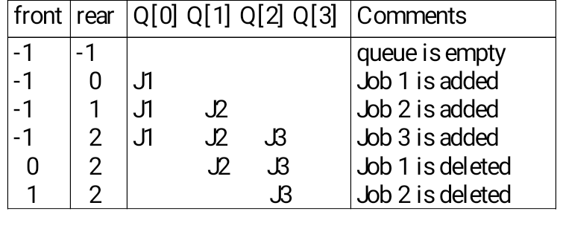
Application: Job scheduling
Insertion and deletion from a sequential queue
CHAPTER 3
‹#›

Slide 11
structure Queue is objects: a finite ordered list with zero or more elements. functions: for all queue ∈ Queue, item ∈ element, max_ queue_ size ∈ positive integer Queue CreateQ(max_queue_size) ::= create an empty queue whose maximum size is max_queue_size Boolean IsFullQ(queue, max_queue_size) ::= if(number of elements in queue == max_queue_size) return TRUE else return FALSE Queue AddQ(queue, item) ::= if (IsFullQ(queue)) queue_full else insert item at rear of queue and return queue Boolean IsEmptyQ(queue) ::= if (queue ==CreateQ(max_queue_size)) return TRUE else return FALSE Element DeleteQ(queue) ::= if (IsEmptyQ(queue)) return else remove and return the item at front of queue.
Abstract data type of queue
CHAPTER 3
‹#›

Slide 12
Queue CreateQ(max_queue_size) ::= # define MAX_QUEUE_SIZE 100/* Maximum queue size */ typedef struct { int key; /* other fields */ } element; element queue[MAX_QUEUE_SIZE]; int rear = -1; int front = -1; Boolean IsEmpty(queue) ::= front == rear Boolean IsFullQ(queue) ::= rear == MAX_QUEUE_SIZE-1 void addq(int *rear, element item) { /* add an item to the queue */ if (*rear == MAX_QUEUE_SIZE - 1) { queue_full( ); return; } queue [++*rear] = item; }
Implementation 1: using array
CHAPTER 3
‹#›

Slide 13
element deleteq(int *front, int rear) { /* remove element at the front of the queue */ if ( *front == rear) return queue_empty( ); /* return an error key */ return queue [++ *front]; } Delete from a queue problem: there may be available space when IsFullQ is true movement is required.
Delete from a queue
CHAPTER 3
‹#›

Slide 14
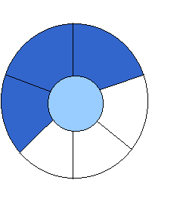
Implementation 2: regard an array as a circular queue
front: one position counterclockwise from the first element
rear: current end
EMPTY QUEUE
[2]
[3] [2] [3]
J2
J3
[1] [4] [1] [4]
J1
[0] [5] [0] [5]
front = 0 front = 0
rear = 0 rear = 3
*Figure 3.6: Empty and nonempty circular queues (p.109)
CHAPTER 3
‹#›

Slide 15
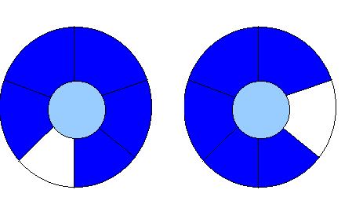
Problem: one space is left when queue is full
FULL QUEUE FULL QUEUE
[2] [3] [2] [3]
J2 J3
J8 J9
J7
[1] [4][1] [4]
J1 J4
J5
J6 J5
[0] [5] [0] [5]
front =0
rear = 5
front =4
rear =3
*Figure 3.7: Full circular queues and then we remove the item (p.110)
CHAPTER 3
‹#›

Slide 16
void addq(int front, int *rear, element item) { /* add an item to the queue */ *rear = (*rear +1) % MAX_QUEUE_SIZE; if (front == *rear) /* reset rear and print error */ return; } queue[*rear] = item; } Add to a circular queue
Add to a circular queue
CHAPTER 3
‹#›

Slide 17
element deleteq(int* front, int rear) { element item; /* remove front element from the queue and put it in item */ if (*front == rear) return queue_empty( ); /* queue_empty returns an error key */ *front = (*front+1) % MAX_QUEUE_SIZE; return queue[*front]; } Delete from a circular queue
Delete from a circular queue
CHAPTER 3
‹#›

Slide 18
Add to a dynamic circular queue
void addq( element item) { /* add an item to the queue */ rear = (rear +1) %capacity if (front == rear) /* reset rear and print error */ {
queuefull();
rear++; } queue[rear] = item; }
CHAPTER 3
‹#›

Slide 19
Doubling queue capacity
void queuefull()
{
element *newqueue;
newqueue=(element *) malloc (2*capacity*sizeof(*queue));
int start =(front+1) % capacity;
if(start<2) /* no wrap around*/
copy(queue+start, queue+start+capacity-1, newqueue);
else
{
copy(queue+start, queue+capacity, newqueue);
copy(queue, queue+rear+1, newqueue+capacity-start);
}
front = 2*capacity-1;
rear = capacity – 2;
capacity = capacity * 2;
free(queue);
queue = newqueue;
}
void copy(element *start, element *end, element *newqueue)
{
int I;
element *j;
j = start;
for (i=0 ; j<end; j++, i++)
*(newqueue+i) = *j;
}
CHAPTER 3
‹#›

Slide 20
Function for displaying elements in a circular queue
void display()
{
int i;
if(front==rear)
{
printf(“empty queue”);
return;
}
for( i = front + 1 % capacity ; i != rear +1 % capacity ; i = i + 1 % capacity )
printf(“ %d”, queue[i].key);
}
CHAPTER 3
‹#›

Slide 21
X = a / b - c + d * e - a * c a = 4, b = c = 2, d = e = 3 Interpretation 1: ((4/2)-2)+(3*3)-(4*2)=0 + 8+9=1 Interpretation 2: (4/(2-2+3))*(3-4)*2=(4/3)*(-1)*2=-2.66666… How to generate the machine instructions corresponding to a given expression? precedence rule + associative rule
Evaluation of Expressions
CHAPTER 3
‹#›

Slide 22
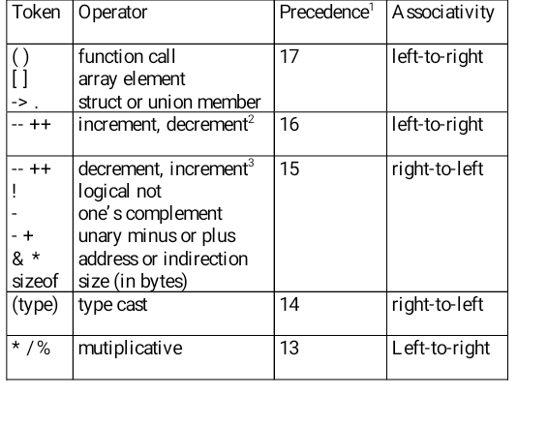
CHAPTER 3
‹#›

Slide 23
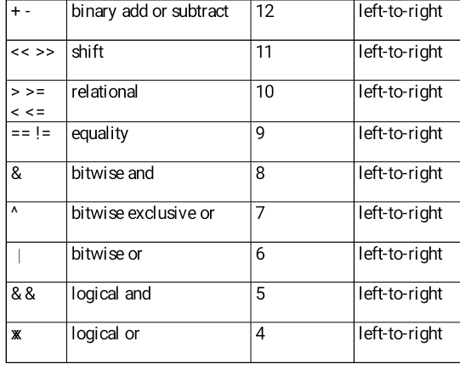
CHAPTER 3
‹#›

Slide 24
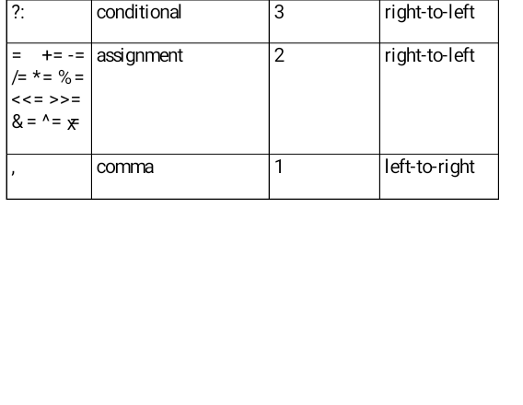
1.The precedence column is taken from Harbison and Steele.
2.Postfix form
3.prefix form
Precedence hierarchy for C
CHAPTER 3
‹#›

Slide 25
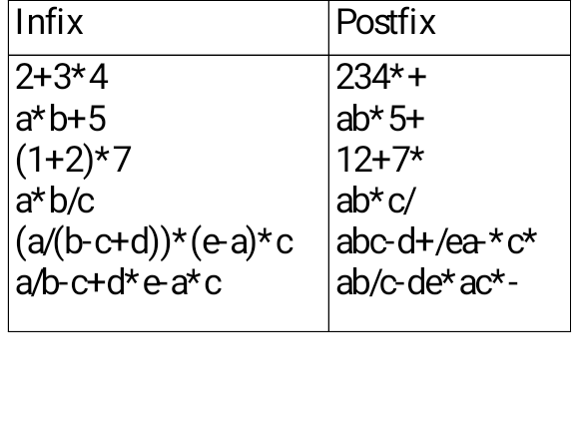

user
compiler
Infix and postfix notation
Postfix: no parentheses, no precedence
CHAPTER 3
‹#›

Slide 26
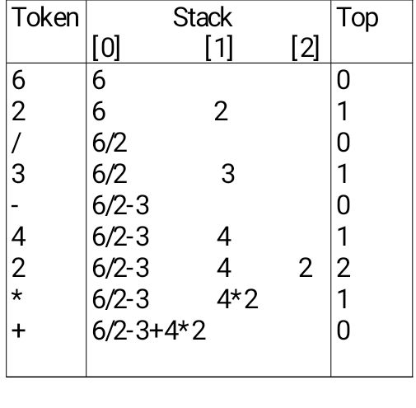
Postfix evaluation
CHAPTER 3
‹#›

Slide 27
#define MAX_STACK_SIZE 100 /* maximum stack size */ #define MAX_EXPR_SIZE 100 /* max size of expression */ typedef enum{lparan, rparen, plus, minus, times, divide, mod, eos, operand} precedence; int stack[MAX_STACK_SIZE]; /* global stack */ char expr[MAX_EXPR_SIZE]; /* input string */
Goal: Evaluation of postfix expression
Assumptions:
operators: +, -, *, /, %
operands: single digit integer
CHAPTER 3
‹#›
Notes:
‹#›

Slide 28
int eval(void) { precedence token; char symbol; int op1, op2; int n = 0; /* counter for the expression string */ int top = -1; token = get_token(&symbol, &n); while (token != eos) { if (token == operand) add(&top, symbol-’0’); /* stack insert */
else { op2 = delete(&top); /* stack delete */ op1 = delete(&top); switch(token) { case plus: add(&top, op1+op2); break; case minus: add(&top, op1-op2); break; case times: add(&top, op1*op2); break; case divide: add(&top, op1/op2); break; case mod: add(&top, op1%op2); } } token = get_token (&symbol, &n); } return delete(&top); }
CHAPTER 3
‹#›

Slide 29
precedence get_token(char *symbol, int *n) { /* get the next token, symbol is the character representation, which is returned, the token is represented by its enumerated value, which is returned in the function name */ *symbol =expr[(*n)++]; switch (*symbol) { case ‘(‘ : return lparen; case ’)’ : return rparen; case ‘+’: return plus; case ‘-’ : return minus; case ‘/’ : return divide; case ‘*’ : return times; case ‘%’ : return mod; case ‘\0‘ : return eos; default : return operand; /* no error checking, default is operand */ } }
CHAPTER 3
‹#›

Slide 30
Infix to Postfix Conversion (Intuitive Algorithm)
(1) Fully parenthesize expression
a / b - c + d * e - a * c -->
((((a / b) - c) + (d * e)) - a * c))
(2) All operators replace their corresponding right
parentheses.
((((a / b) - c) + (d * e)) - a * c))
(3) Delete all parentheses.
ab/c-de*+ac*-
two passes
/
-
*
+
*
-
CHAPTER 3
‹#›

Slide 31
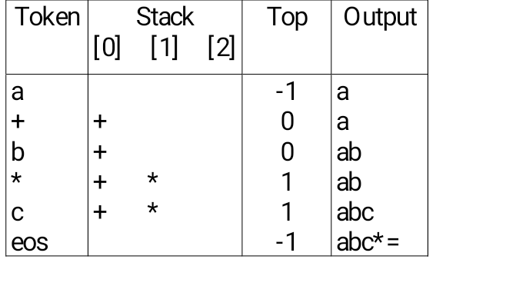
The orders of operands in infix and postfix are the same.
a + b * c, * > +
*Figure 3.15: Translation of a+b*c to postfix (p.124)
CHAPTER 3
‹#›

Slide 32
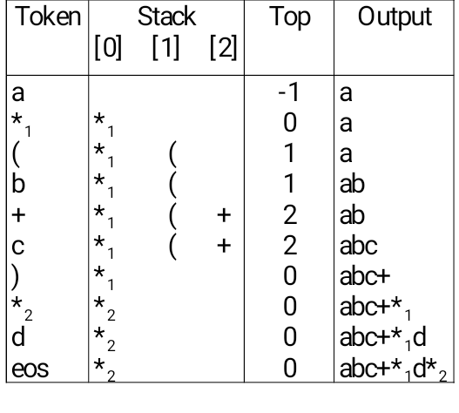
a *₁ (b +c) *₂ d
match )
*₁ = *₂
CHAPTER 3
‹#›
Translation of a*(b+c)*d to postfix

Slide 33
Rules
(1) Operators are taken out of the stack as long as their
in-stack precedence is higher than or equal to the
incoming precedence of the new operator.
(2) ( has low in-stack precedence, and high incoming
precedence.
( ) + - * / % eos
isp 0 19 12 12 13 13 13 0
icp 20 19 12 12 13 13 13 0
CHAPTER 3
‹#›

Slide 34
precedence stack[MAX_STACK_SIZE]; /* isp and icp arrays -- index is value of precedence lparen, rparen, plus, minus, times, divide, mod, eos */ static int isp [ ] = {0, 19, 12, 12, 13, 13, 13, 0}; static int icp [ ] = {20, 19, 12, 12, 13, 13, 13, 0};
isp: in-stack precedence
icp: incoming precedence
CHAPTER 3
‹#›

Slide 35
void postfix(void) { /* output the postfix of the expression. The expression string, the stack, and top are global */ char symbol; precedence token; int n = 0; int top = 0; /* place eos on stack */ stack[0] = eos; for (token = get _token(&symbol, &n); token != eos; token = get_token(&symbol, &n)) { if (token == operand) printf (“%c”, symbol); else if (token == rparen ){
CHAPTER 3
‹#›

Slide 36
/*unstack tokens until left parenthesis */ while (stack[top] != lparen) print_token(delete(&top)); delete(&top); /*discard the left parenthesis */ } else{ /* remove and print symbols whose isp is greater than or equal to the current token’s icp */ while(isp[stack[top]] >= icp[token] ) print_token(delete(&top)); add(&top, token); } } while ((token = delete(&top)) != eos) print_token(token); print(“\n”); } Function to convert from infix to postfix
CHAPTER 3
‹#›

